Slide 1

FUNDWise
Online Banking Platform
Presented by :​
​ DEEPRAJ SANTOSH GHADASHI 230320520034
​ JAYDEEP DATTATRAY BHOGATE 230320520047
AMAR SANJAY BAGAL 230320520027
NEHA KHAN MOIEN KHAN 230320520066

Slide 2

Project oVERVIEW
Online Banking System is a dynamic web-based application by using which customer can perform multiple operations like money withdraw, deposit and do the money transfer
User can see check the available balance and can see the transaction history.
The primary objectives of this project are administration login and user login ultimately leading to security of money.

Slide 3






Technology used
FRONT-END
BACK-END
DATABASE
REACT.JS
CSS
HTML
JAVA SCRIPT
SPRING BOOT
MySQL
TESTING
POSTMAN

Slide 4

User Modules in Online Banking Systems
1) ADMINISTRATOR MODULE
2) CUSTOMER MODULE

Slide 5
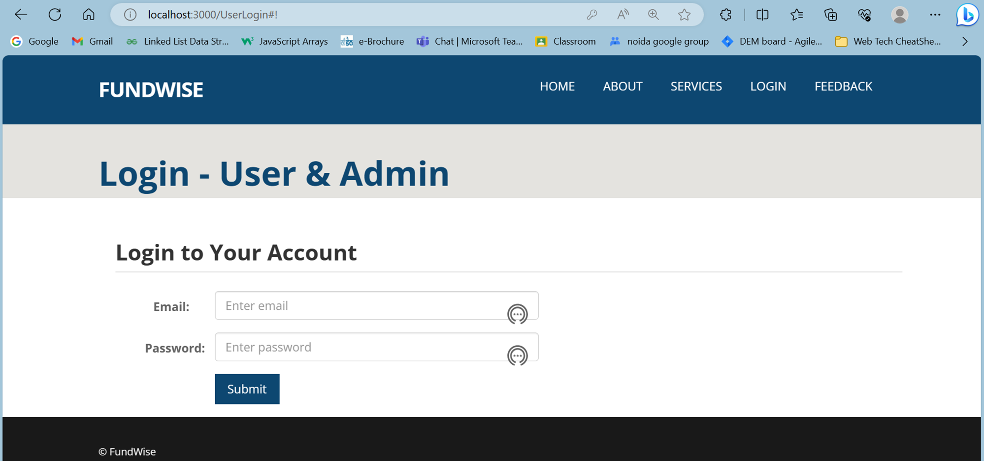

Slide 6

Project Details
The project contains 2 modules Admin & User. So firstly Admin will register, and login into the system, and firstly he can Add the Bank Branches. After this Admin will Register the Customer in the Bank.
Now Once the User is registered in the Bank, now Admin can Add Bank Account (Saving or Current) for this User.
Note: At the time of Account creation, Initially the Account Status for the same will be OPEN, which means admin can do the Transactions now like (Withdraw, Deposit, and Account Transfer).
Now Once the User is registered and his Account is Opened, Now the Customer can perform Bank Transactions like Withdraw, Deposit, and Transfer Money to another Account and can also check the Account Balance.
After this Customer will be able to see his Transaction history, can see his Profile, and Account Details and he can Request for the Checkbook.
Now Admin will log in and he can Approve user request. In the end, Admin will be able to see all the users, all user accounts, and all the Transactions done by the Customers.

Slide 7
Functional Modules
1) User Authentication Module:
The registration and Login system using spring boot and react has been added so that only authenticated users (Admin or Customer) can perform their functionalities.
2) Account Module:
Add Bank Account, Add Bank Branch, View Bank Accounts, and KYC and Open Bank Account.
3) Account Transaction Module:
Withdraw Money, Deposit Amount, Money Transfer, View Account Balance, View My Transaction History, View all Transactions History.
4) Feedback Module:
User can give feedback and it will directly reflect to admin

Slide 8
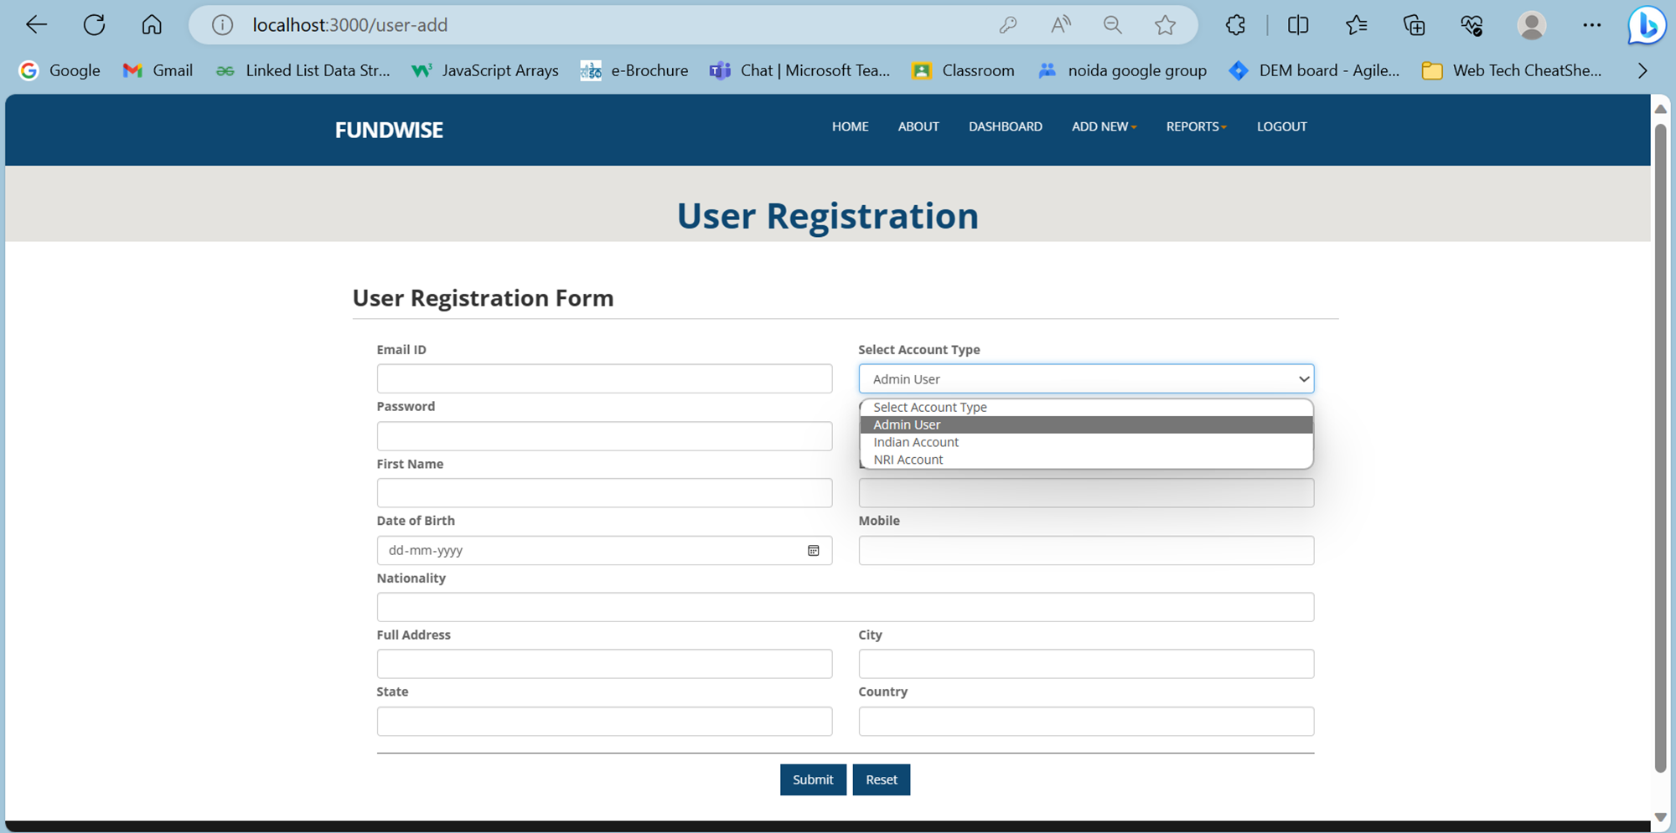

Slide 9
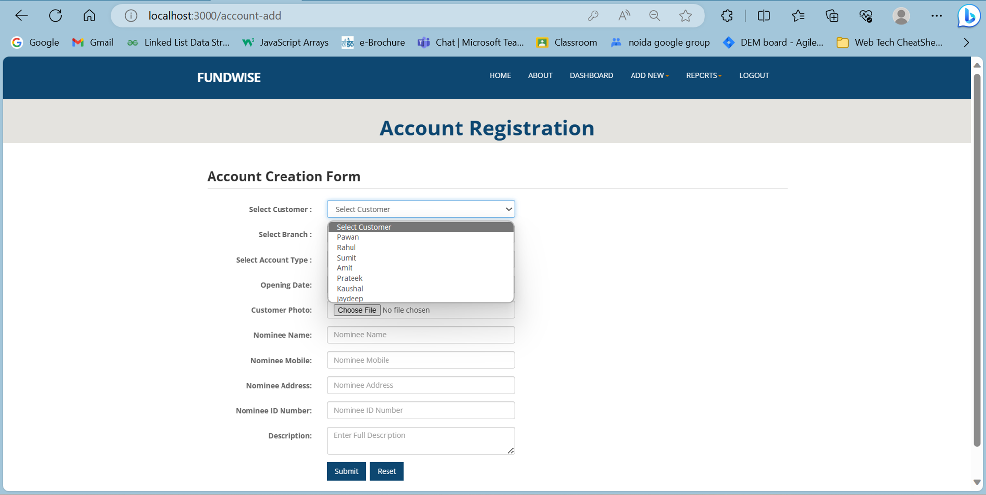

Slide 10
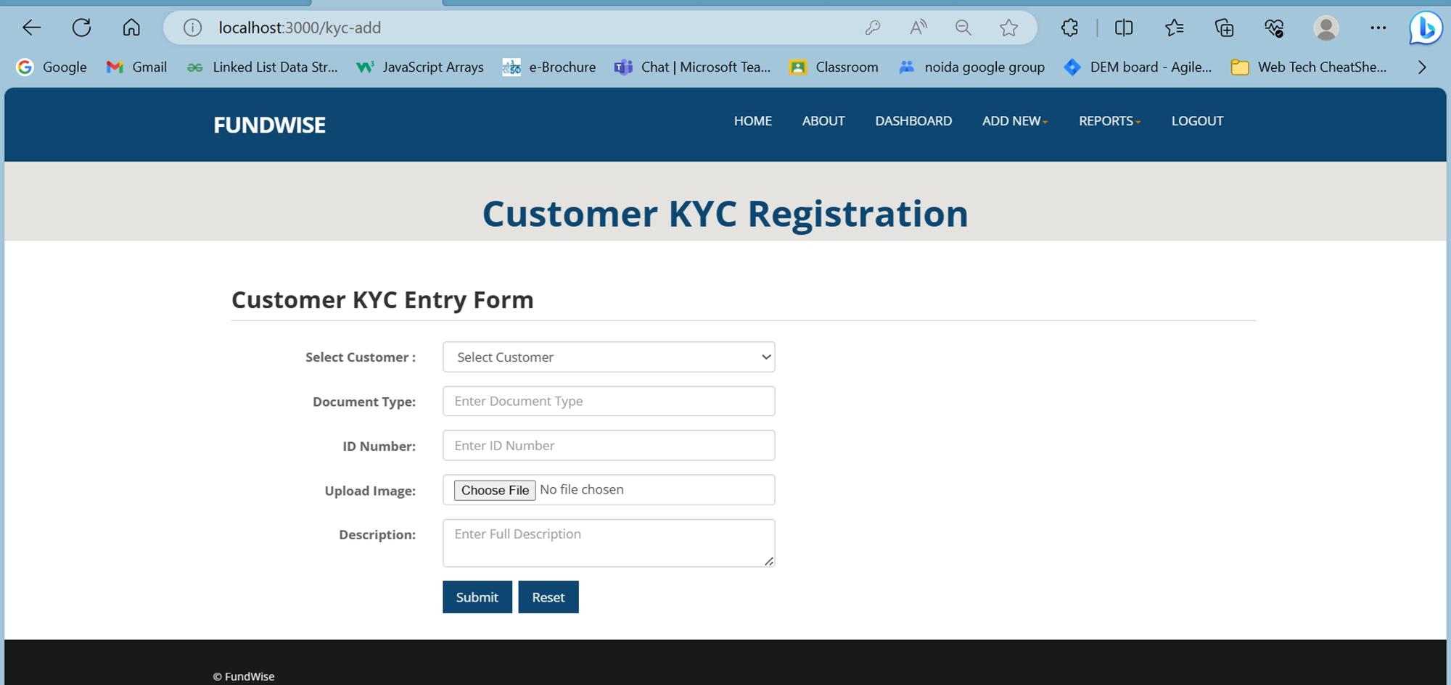

Slide 11
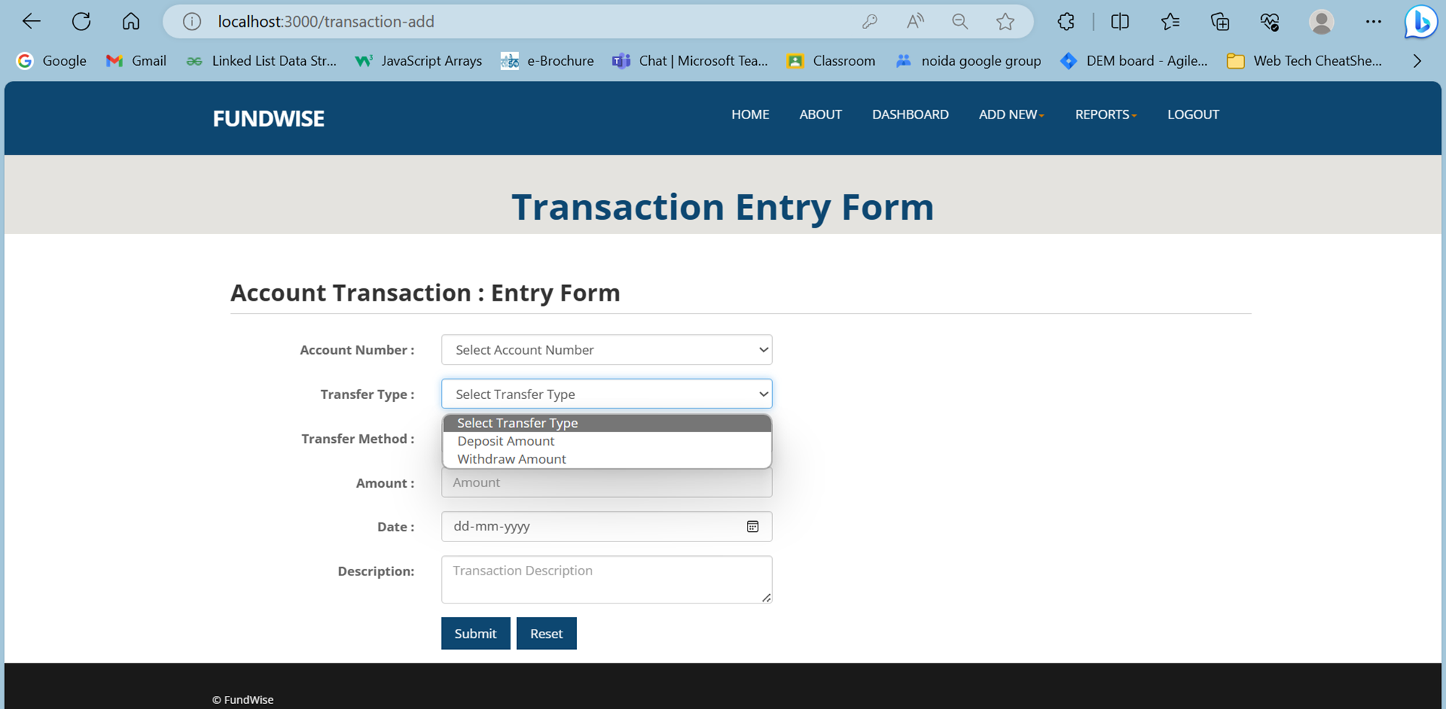
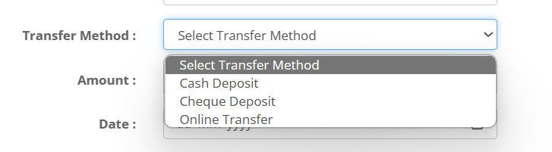

Slide 12
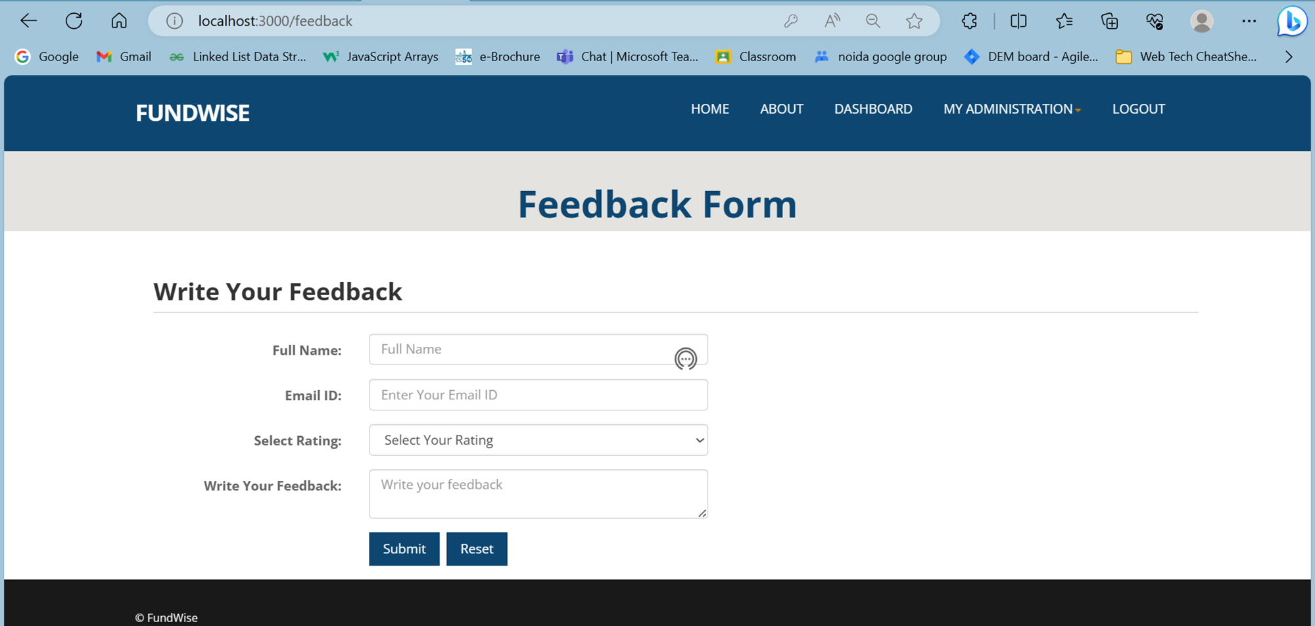
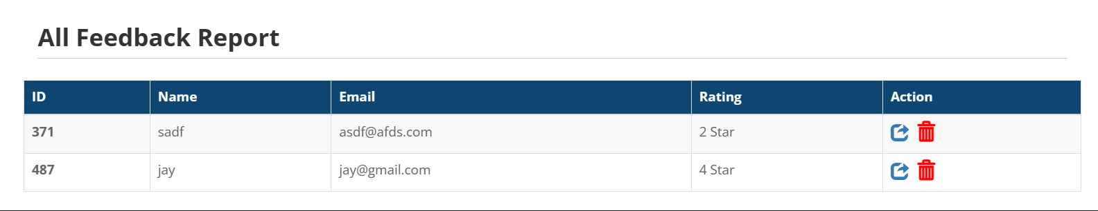

Slide 13
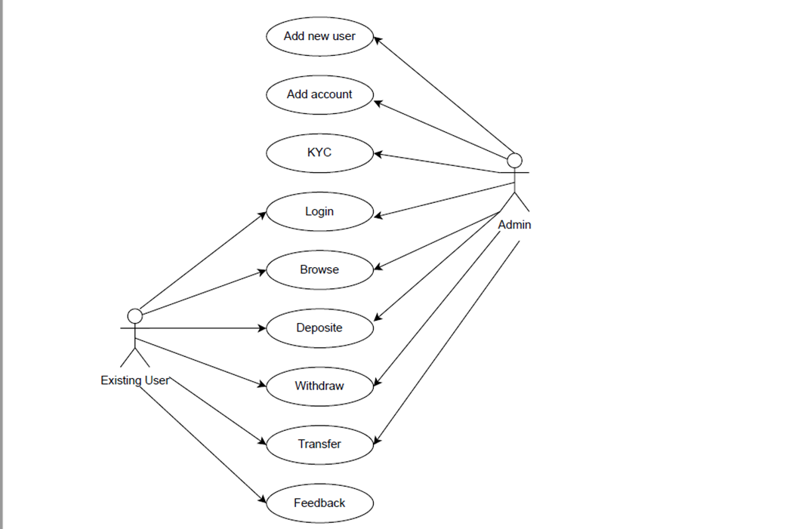

Slide 14
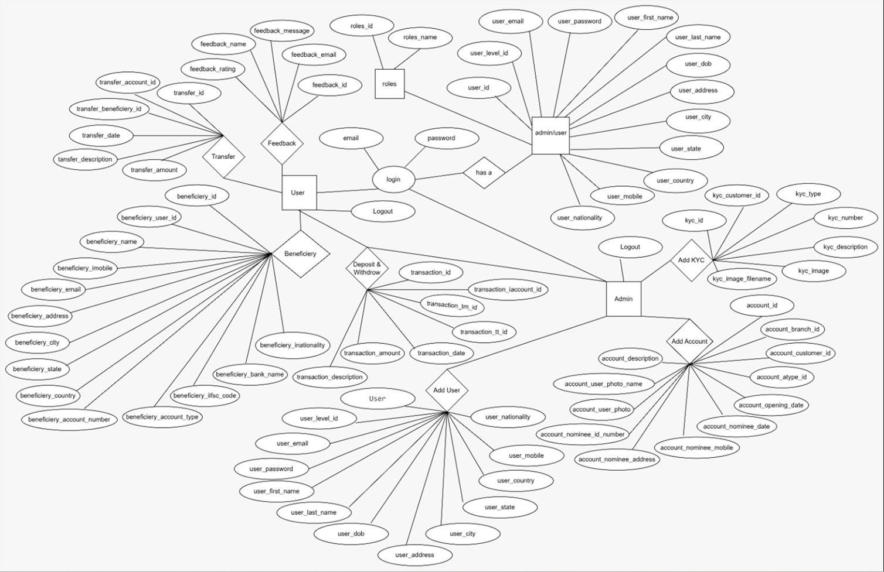

Slide 15
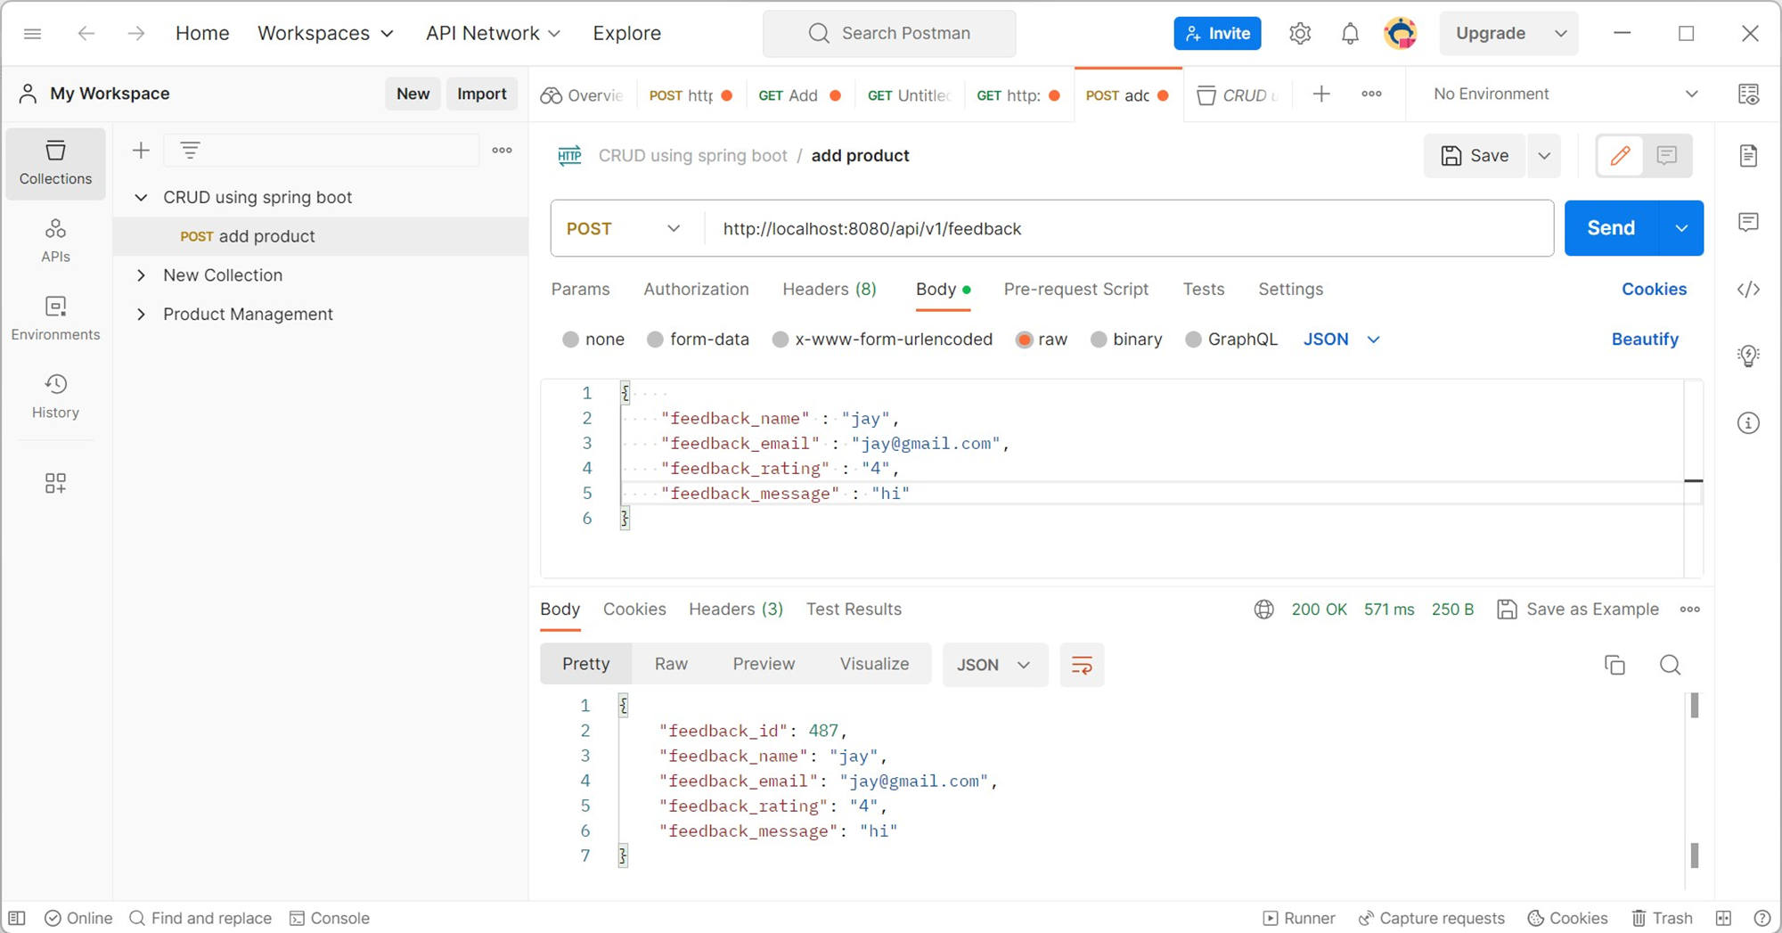

Slide 16


THANK YOU

